Slide 1
Home finder mobile Application
Xu Zhang
Seidenberg School of CSIS, Pace University, New York

Slide 2
Agenda
Introduction
Why this app?
App functionalities
Development process
Tech Stack
Implementation details

Slide 3
Introduction
This mobile application helps users find suitable and available houses which will meet their needs in New Jersey.

Slide 4
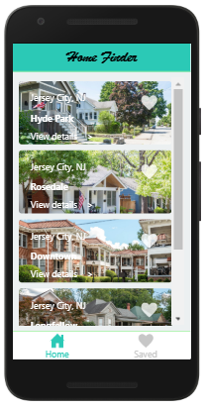
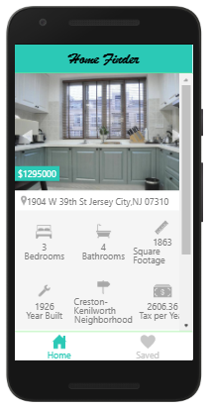
Introduction
Users can find the house information in the app and browse the data of these houses in detail such as pictures overview, facts and features, price and tax history , neighborhood and location and so on.

Slide 5
Why this app
Shopping for a new home can be a challenging and time-consuming endeavor. Driving to view neighborhoods and properties, touring homes, and locating the nearby schools and supermarkets can be an additional part-time job when you add house-hunting to your busy life.
Home searching apps can reduce and streamline this time investment considerably. You can search within the long list of what’s for sale so that you only see the listings that fit your criteria. From there, you start ruling out the ones you don’t like until you have your shortlist. Then you can drive to visit just those homes.

Slide 6
App Functionalities
Welcome page: display the logo and the name of this app
Listing of all houses in New Jersey
When users click one of the house, the data of the house will display in detail
Users can save the houses they are interested
The listing page of the user’s interest
The navigation bar at the bottom, users can switch freely between the user’s interest page and the list of housing page.

Slide 7
Development Process
Requirement analysis
Sketch design
Interaction design
Static page coding
Data design
Function design and coding
Interactive function coding

Slide 8



Tech Stack
Front end: React Native
Back end: Java Springboot
Database: MySql

Slide 9
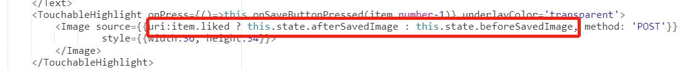
Presentation Layer
JSX

Slide 10
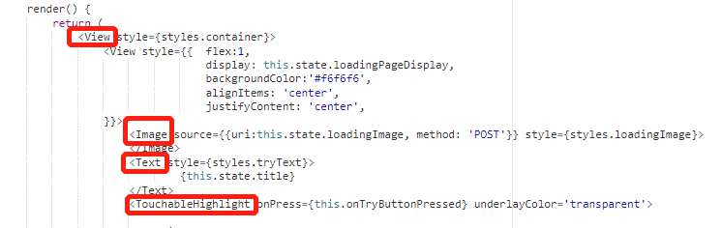
Presentation Layer
RN components
View,ScrollView
Text, TextInput
ImageBackground, Image
TouchableHight
StyleSheet Dimensions

Slide 11
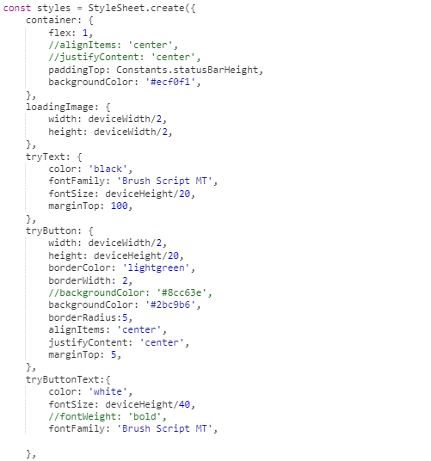
Presentation Layer
RN StyleSheet
Stylesheet is similar to cascading style sheets (CSS),
It help us to write the style and layout of the app page

Slide 12
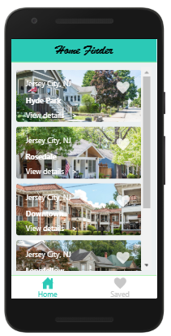
Presentation Layer
flex:1
Flex & Dimensions
Flex
Using flex to split page in proportion.
Dimensions
Using dimensions to set precise font size, width and height for elements of pages.
flex:9
deviceWidth - 40,
deviceHeight/5,
flex:1

Slide 13
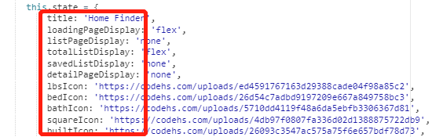

Data Layer
RN state
Data type & data objects
*Note：
We can't directly update the data of array object. We need to get the copy of the array object, update the value of the copy object, and then call the setState() function to update the array object.

Slide 14
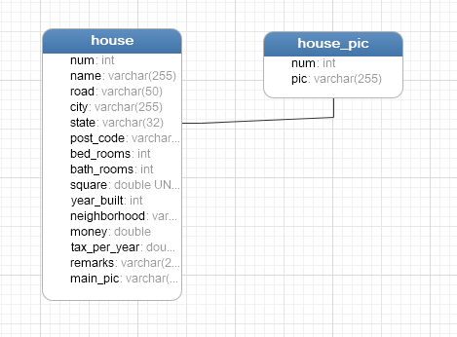
Data Layer
Database: MySql
Table: house
includes basic housing information
Table: house_pic
includes list of house pictures

Slide 15
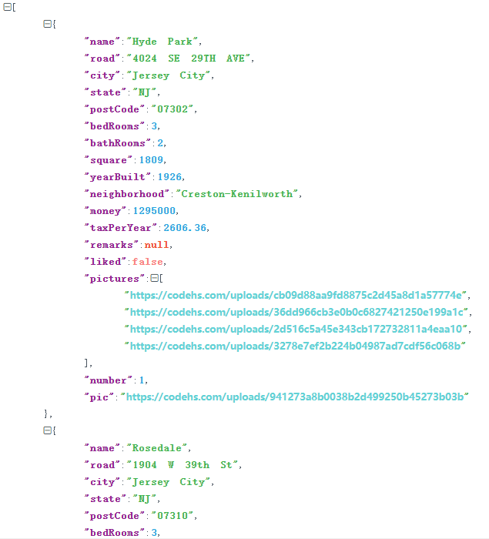
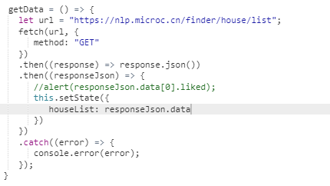
Data Layer

Slide 16
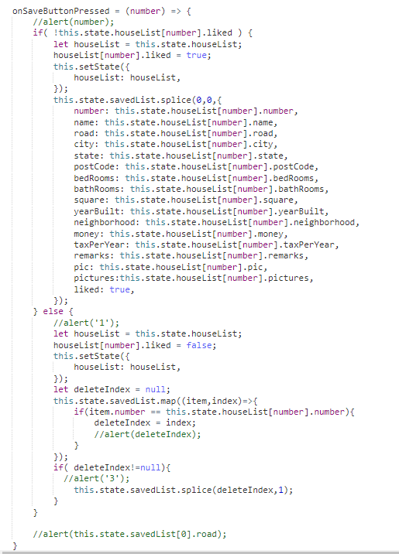
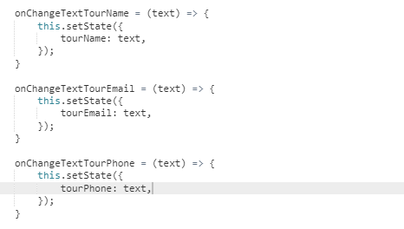
Data Layer
RN Function
Notes:
我们可以把相同功能的代码封装到函数里，调用函数时传入不同的参数来处理逻辑分支。RN function encapsulate the code with the same functions into one, and pass in different parameters when calling the function to handle the logic branch.

Slide 17
Interaction Layer
To develop an interactive function, it includes three steps: variable declaration, event capture and event processing.
It also includes three parts of developing contents: state data, components of presentation layer and functions.

Slide 18
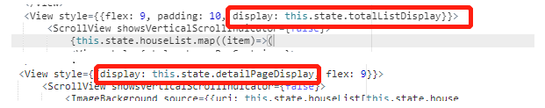
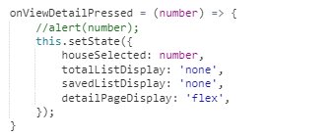


Interaction Layer
Switching between house list and house details :
Variable binding
Variable declaration
Event Capturing
Event processing
state
TouchableHight
Function

Slide 19
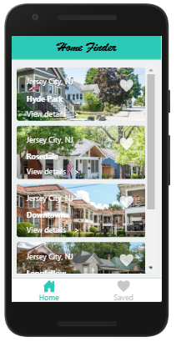
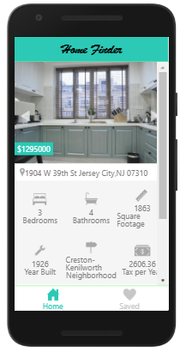
Interaction Layer

Slide 20
References
1. https://reactnative.dev/docs/scrollview
2. https://reactjs.org/docs/handling-events.html
3. http://www.hackingwithreact.com/read/1/13/rendering-an-array-of-data-with-map-and-jsx
4. https://reactnative.dev/docs/touchablehighlight

Slide 21
Thank you!

